Slide 1
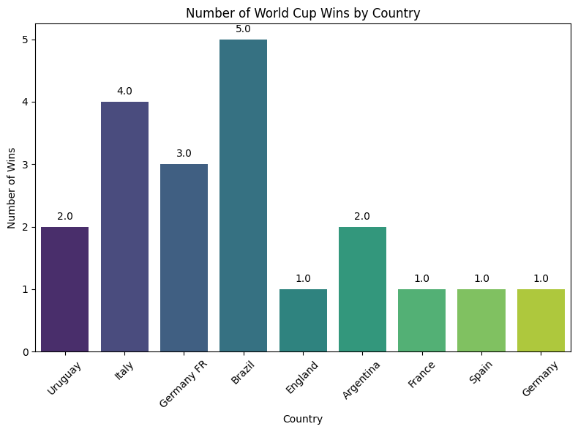
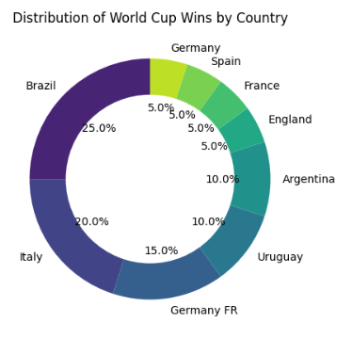
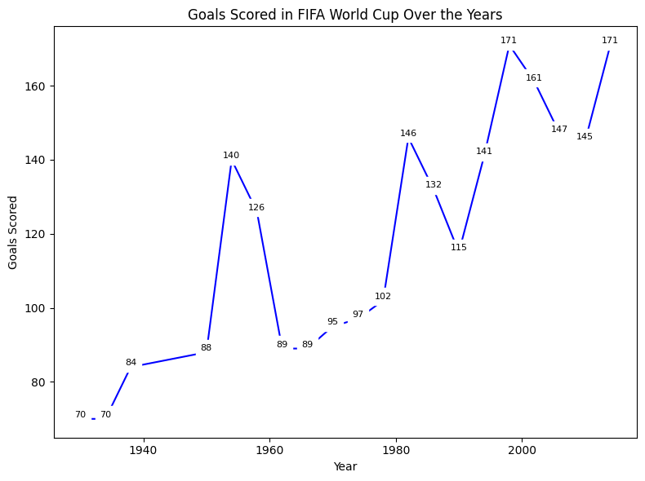
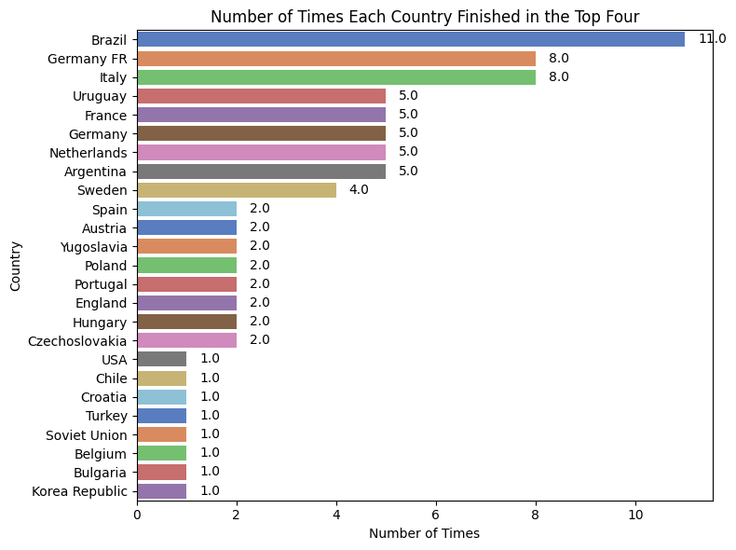
FiFa world cups insights
The dashboard shows the FIFA world cup insights.
The trend graph shows the goal scored in FIFA world over the years.
The donut figure shows the distribution of world cup wins by a country.
Student name: Ahsan Farooq
Student ID:22080535

